Slide 1
FINANCIAL RISK VISUALIZATION
16-DASHBOARD TEAM PLAN
Milestone 3: Dashboard Development
Presentation Focus
• Customer and financial risk overview
• Risk surface and segment-level analysis
• Two-page high-risk customer analysis
• Risk distribution and assessment coverage
Milestone – 3
Infosys Internship • Data Visualization TEAM – 5
TEAM 5 • 1

Slide 2
Project Objective & Dashboard Approach
Objective
• Convert financial customer data into interactive visual insights.
• Identify high-, medium- and low-risk customer segments.
• Compare risk across geography, employment and loan purpose.
• Support faster identification of risk concentration and customer patterns.
Workflow
• Data preparation and cleaning
• Field validation and segmentation
• Risk categorization
• Visual design and layout
• Interactive analysis and validation

Slide 3
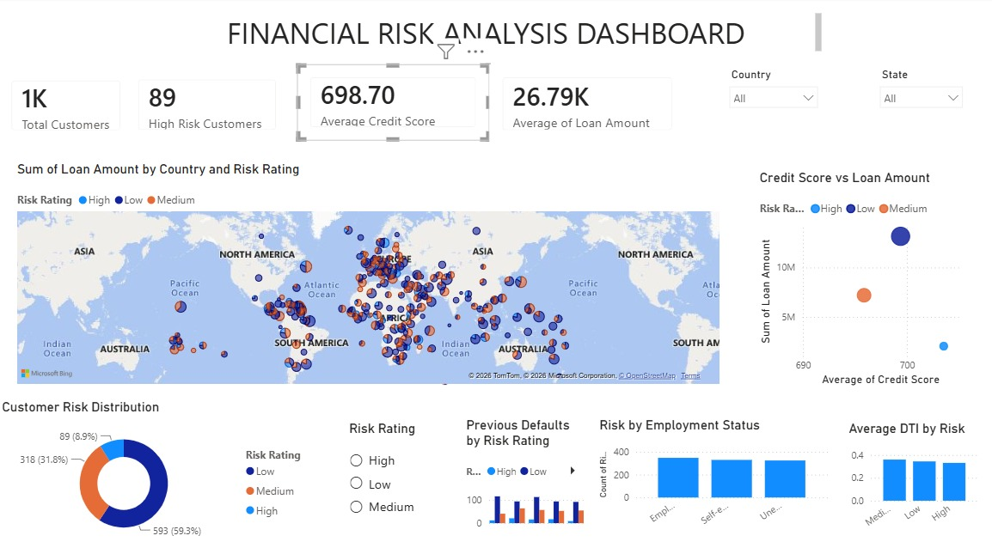
Dashboard 1 — Financial Risk Analysis Dashboard
Owner: Person 1 • Existing dashboard retained
Presentation focus
• Customer KPIs and risk distribution
• Geographic loan exposure
• Credit score vs loan amount
• Employment and DTI context
TEAM 5 • 3

Slide 4
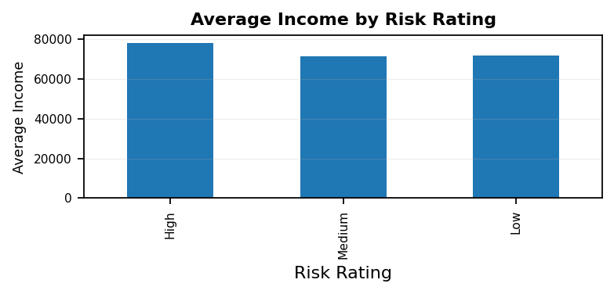
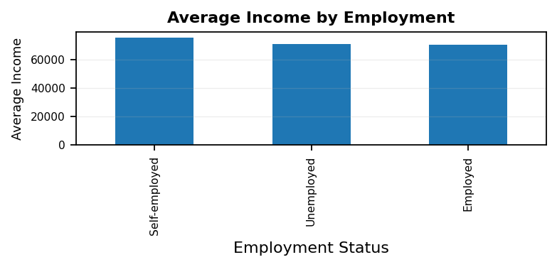
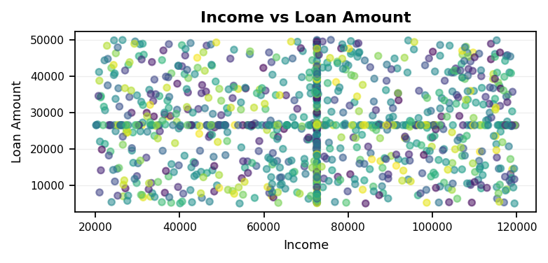
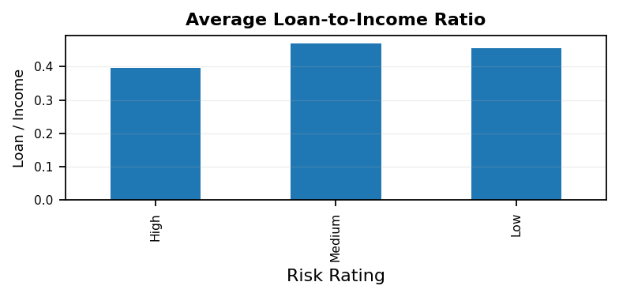
Dashboard 2 — Income & Financial Capacity
Owner: Person 1 • New dashboard — distinct analytical theme
1,000
89
698.7
26.8K
Total Records
High-Risk Customers
Average Credit Score
Average Loan Amount
TEAM 5 • 8

Slide 5
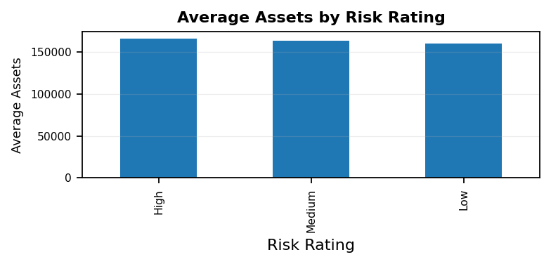
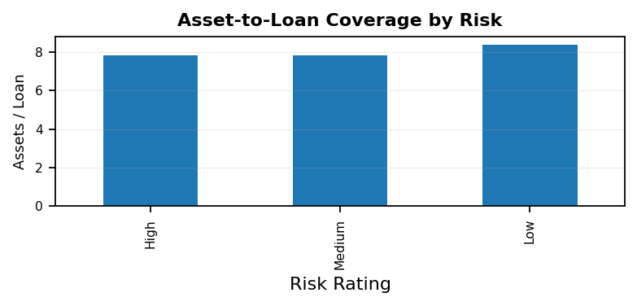
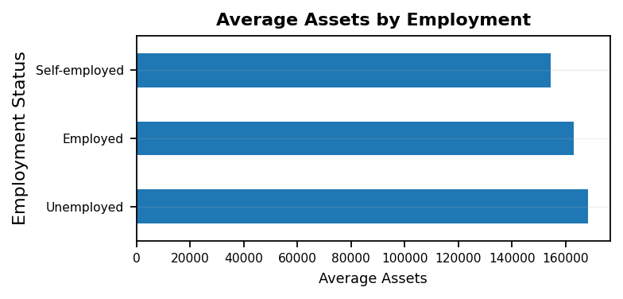
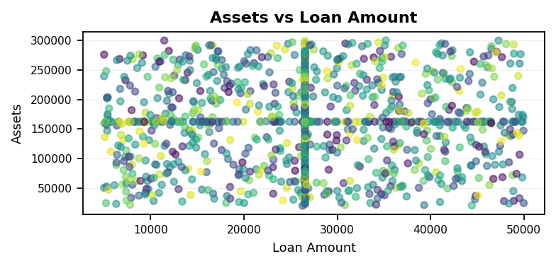
Dashboard 3 — Assets & Financial Strength
Owner: Person 1 • New dashboard — distinct analytical theme
1,000
89
698.7
26.8K
Total Records
High-Risk Customers
Average Credit Score
Average Loan Amount
TEAM 5 • 9

Slide 6
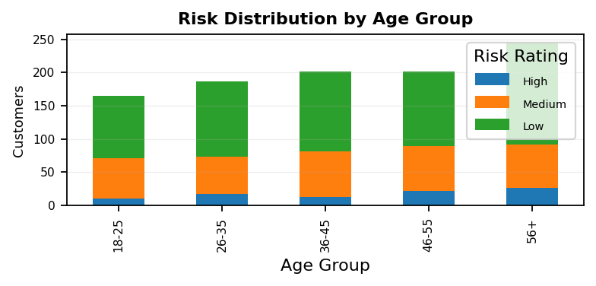
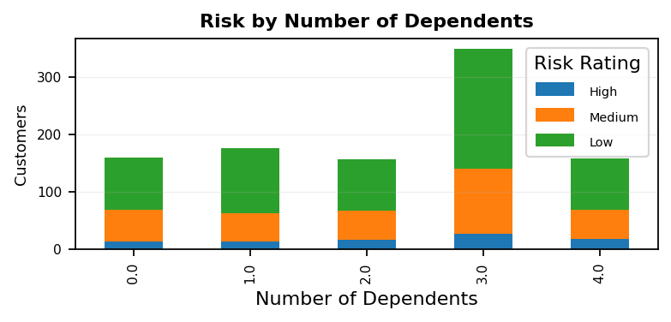
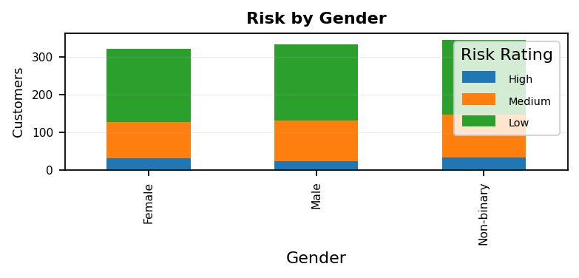
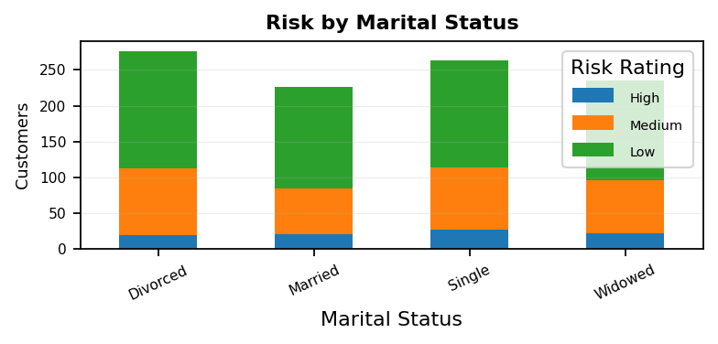
Dashboard 4 — Customer Demographics & Risk
Owner: Person 1 • New dashboard — distinct analytical theme
1,000
89
698.7
26.8K
Total Records
High-Risk Customers
Average Credit Score
Average Loan Amount
TEAM 5 • 10

Slide 7
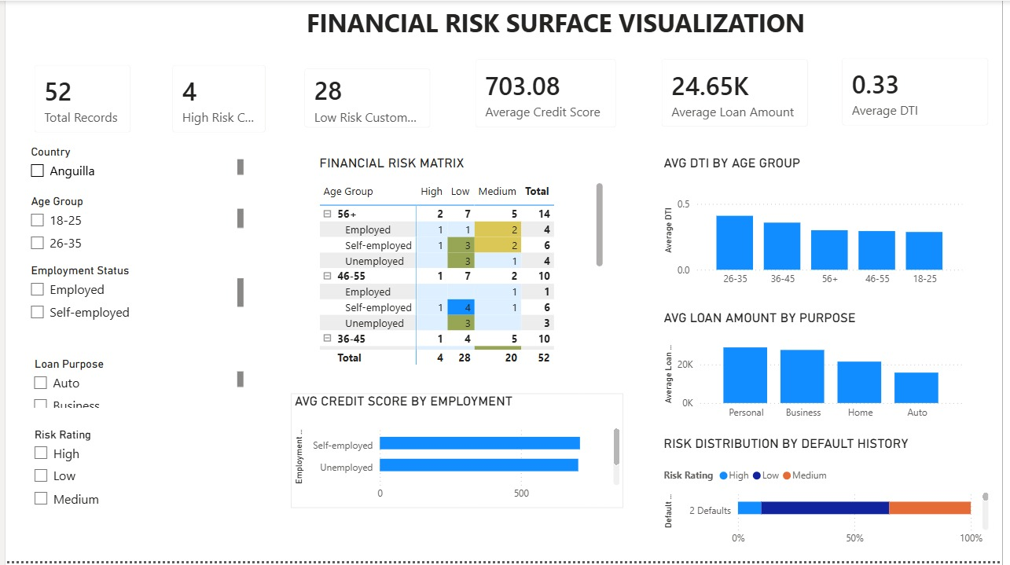
Dashboard 5 — Financial Risk Surface Visualization
Owner: Person 2 • Existing dashboard retained
Presentation focus
• Risk matrix by age and employment
• Average DTI by age group
• Loan amount by purpose
• Default history and credit score
TEAM 5 • 4

Slide 8
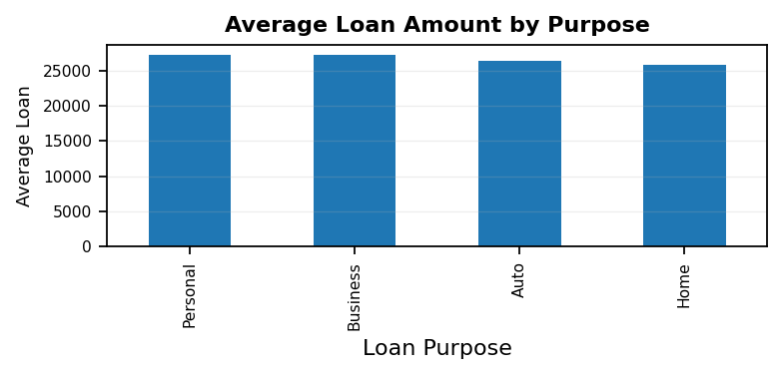
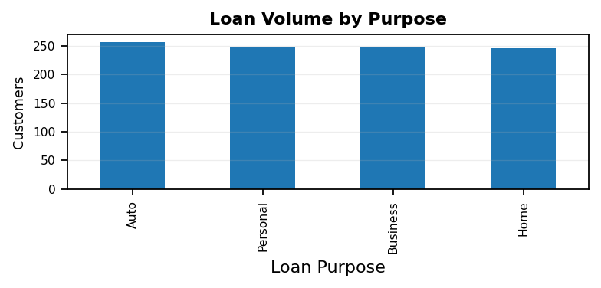
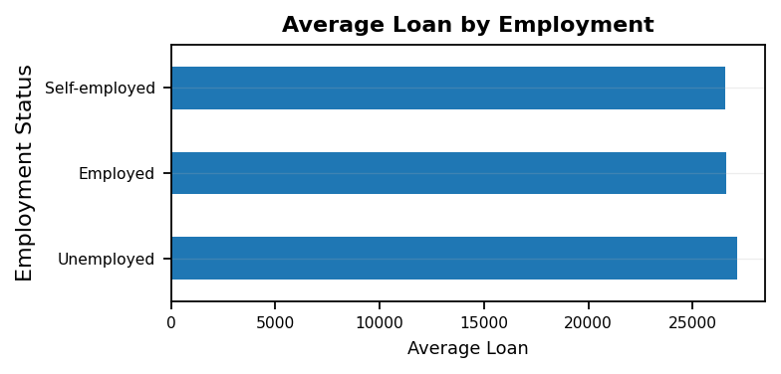
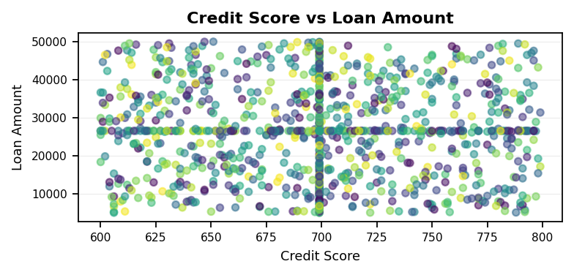
Dashboard 6 — Loan Portfolio & Purpose
Owner: Person 2 • New dashboard — distinct analytical theme
1,000
89
698.7
26.8K
Total Records
High-Risk Customers
Average Credit Score
Average Loan Amount
TEAM 5 • 11

Slide 9
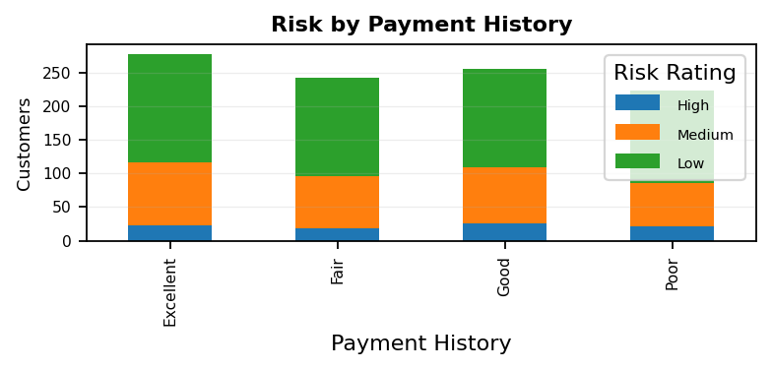
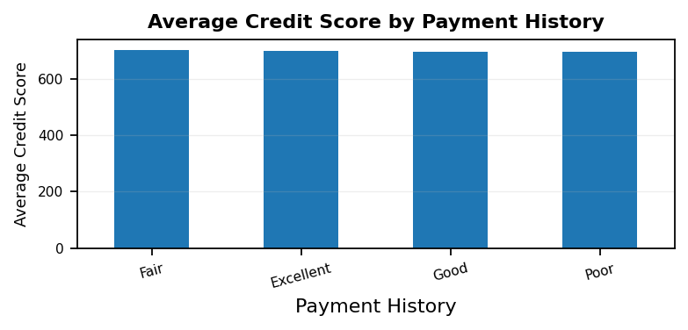
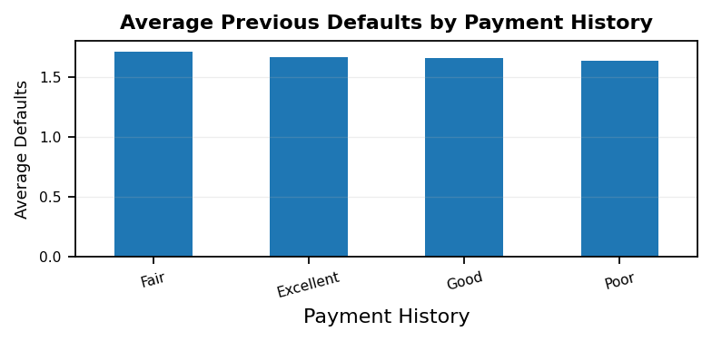
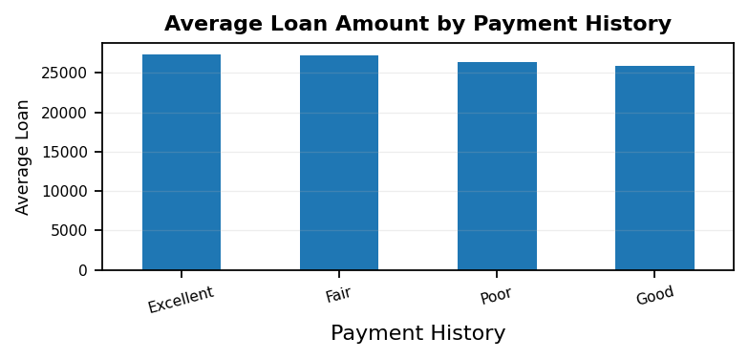
Dashboard 7 — Payment Behavior & Credit History
Owner: Person 2 • New dashboard — distinct analytical theme
1,000
89
698.7
26.8K
Total Records
High-Risk Customers
Average Credit Score
Average Loan Amount
TEAM 5 • 12

Slide 10
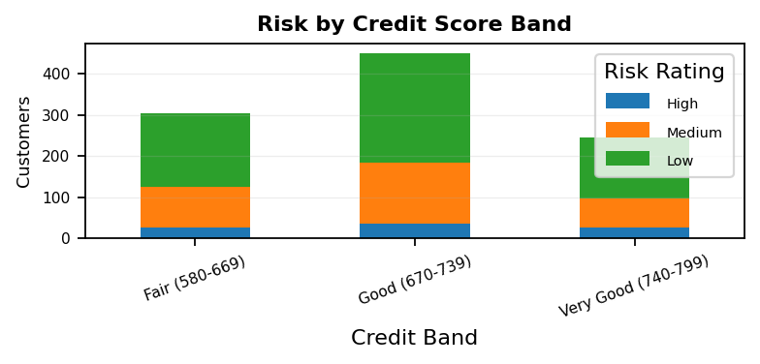
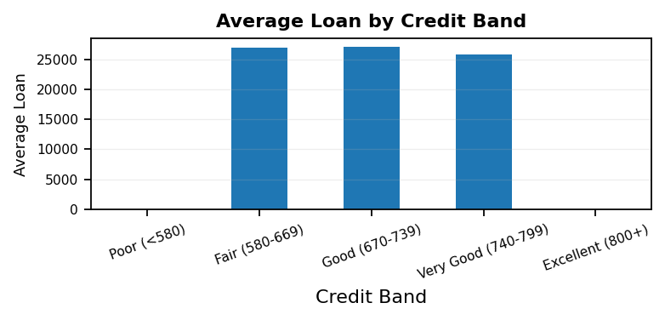
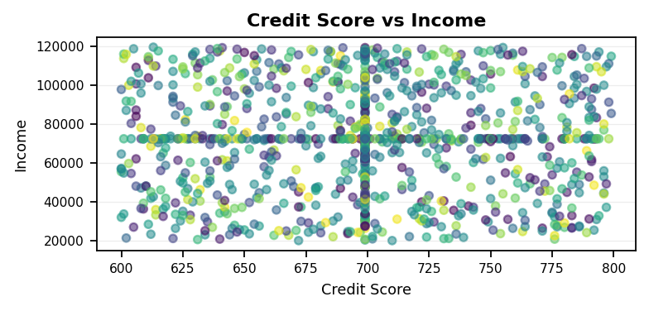
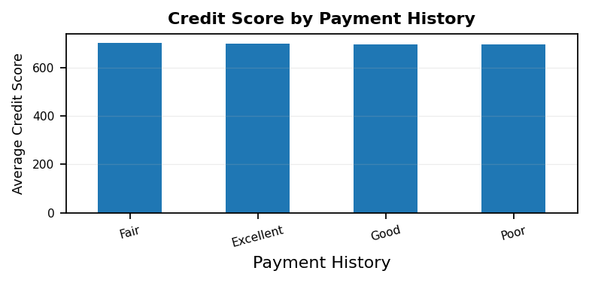
Dashboard 8 — Credit Quality & Exposure
Owner: Person 3 • New dashboard — distinct analytical theme
1,000
89
698.7
26.8K
Total Records
High-Risk Customers
Average Credit Score
Average Loan Amount
TEAM 5 • 16

Slide 11
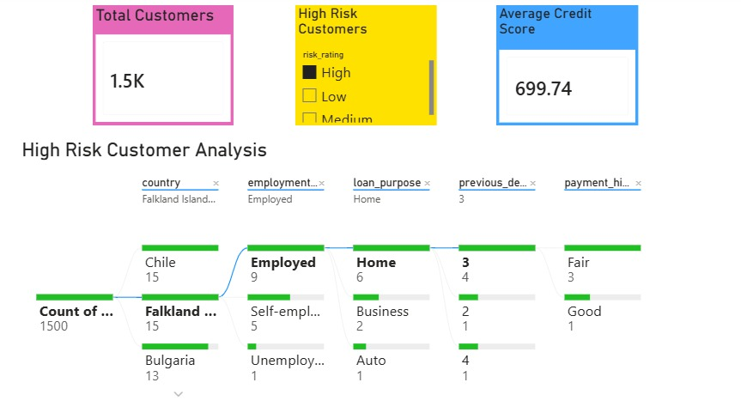
Dashboard 9 — High Risk Customer Analysis | Page 1
Owner: Person 3 • Existing dashboard retained
Presentation focus
• High-risk customer drill-down
• Country and employment filters
• Loan purpose and default history
• Payment-history exploration
TEAM 5 • 5

Slide 12
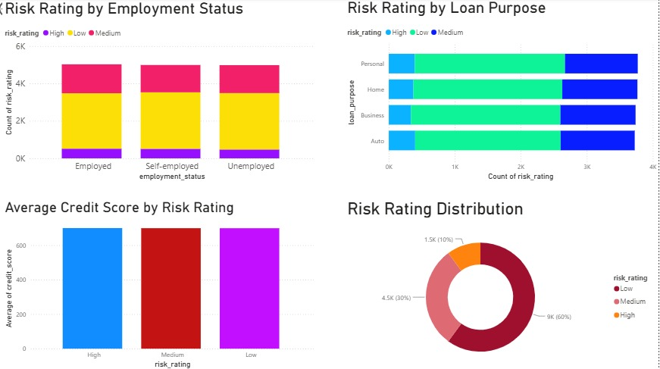
Dashboard 9 — High Risk Customer Analysis
Owner: Person 3 • Existing dashboard retained
Presentation focus
• Risk by employment status
• Risk by loan purpose
• Average credit score by risk
• Overall risk distribution
TEAM 5 • 6

Slide 13
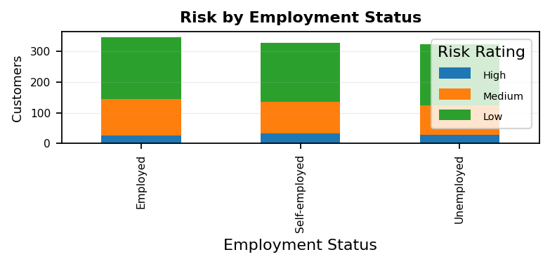
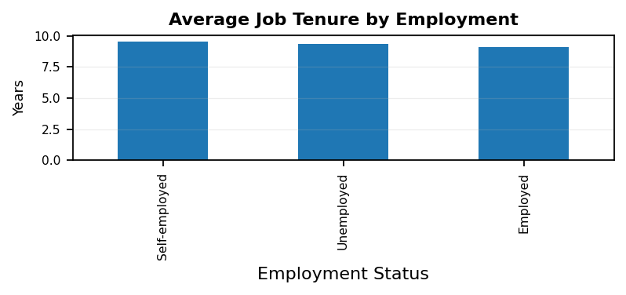
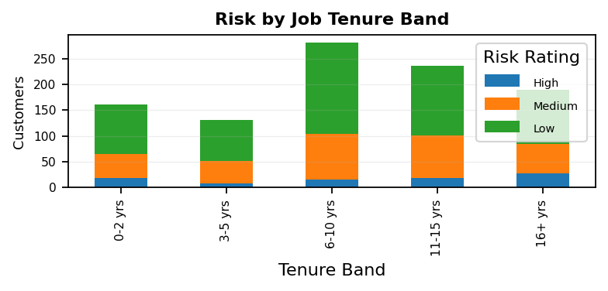
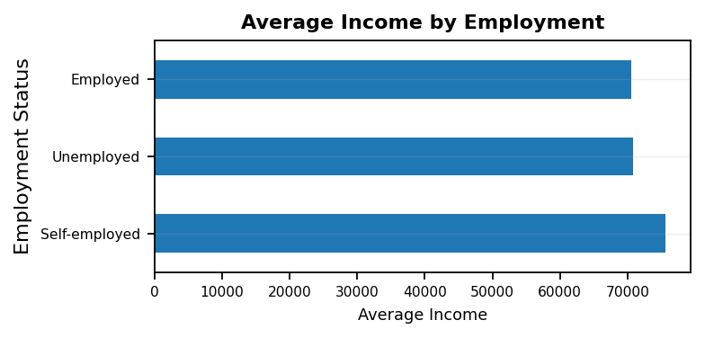
Dashboard 10 — Employment Stability
Owner: Person 2 • New dashboard — distinct analytical theme
1,000
89
698.7
26.8K
Total Records
High-Risk Customers
Average Credit Score
Average Loan Amount
TEAM 5 • 13

Slide 14
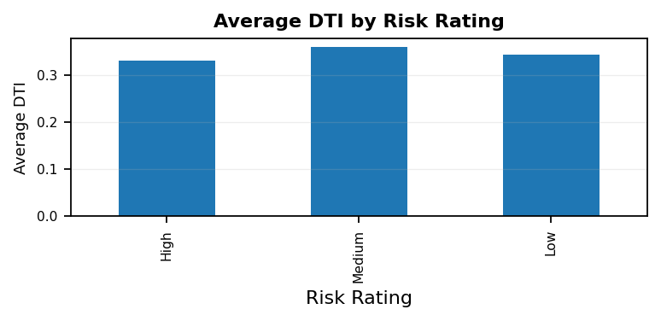
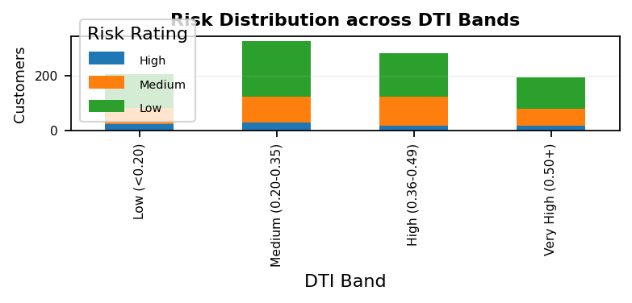
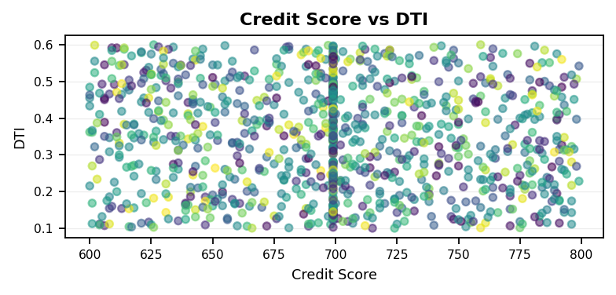
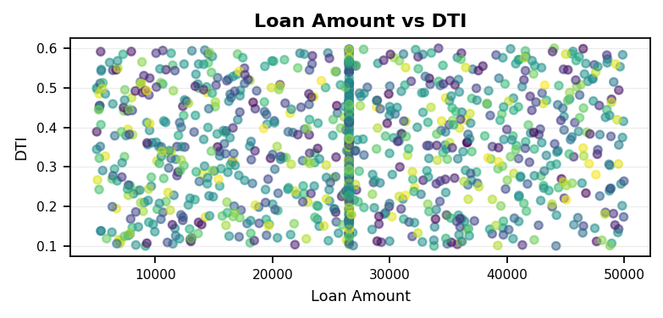
Dashboard 11 — Debt-to-Income & Financial Stress
Owner: Person 3 • New dashboard — distinct analytical theme
1,000
89
698.7
26.8K
Total Records
High-Risk Customers
Average Credit Score
Average Loan Amount
TEAM 5 • 14

Slide 15
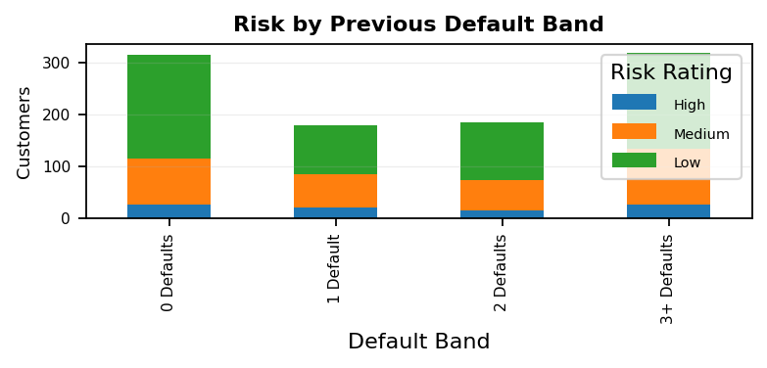
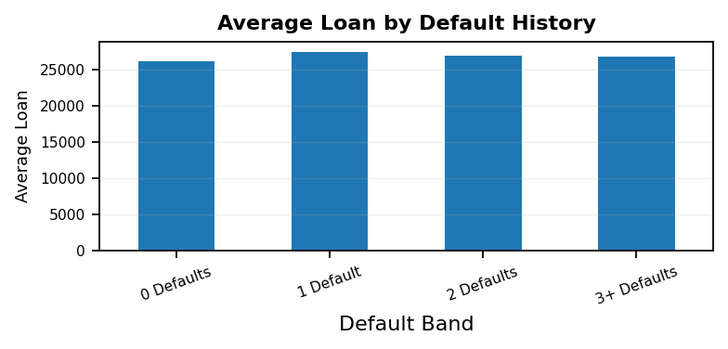
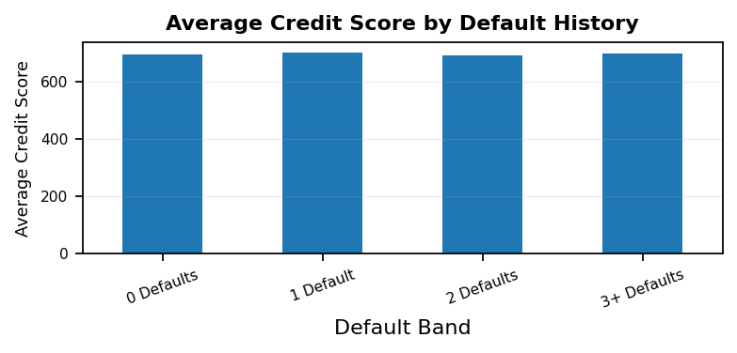
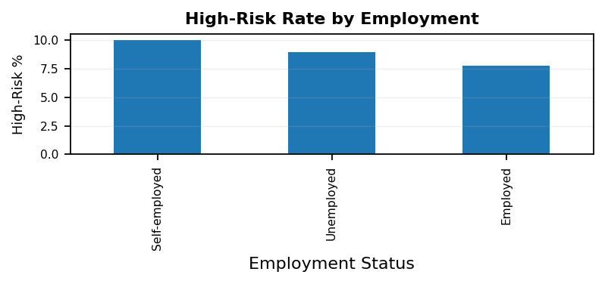
Dashboard 12 — Default Risk & Repayment Exposure
Owner: Person 3 • New dashboard — distinct analytical theme
1,000
89
698.7
26.8K
Total Records
High-Risk Customers
Average Credit Score
Average Loan Amount
TEAM 5 • 15

Slide 16
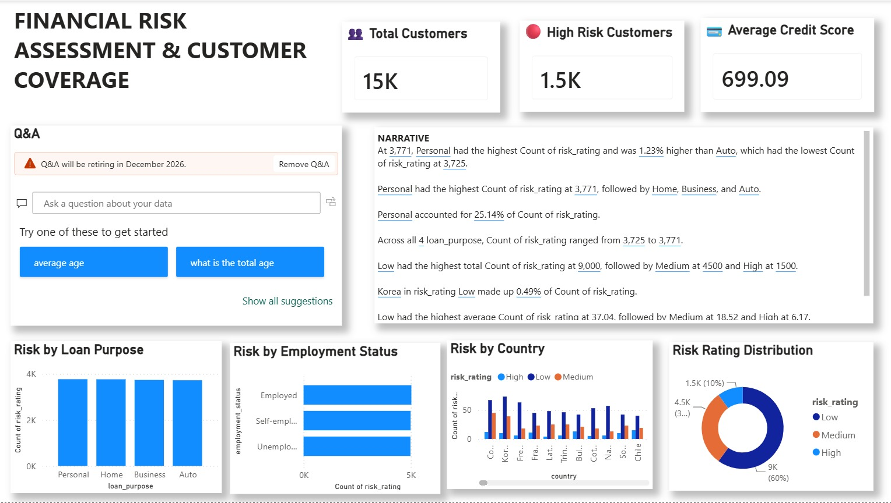
Dashboard 13 — Financial Risk Assessment & Customer Coverage
Owner: Person 4 • Existing dashboard retained
Presentation focus
• KPI summary and customer coverage
• Q&A and narrative insights
• Risk by loan purpose and employment
• Country-level risk distribution
TEAM 5 • 7

Slide 17
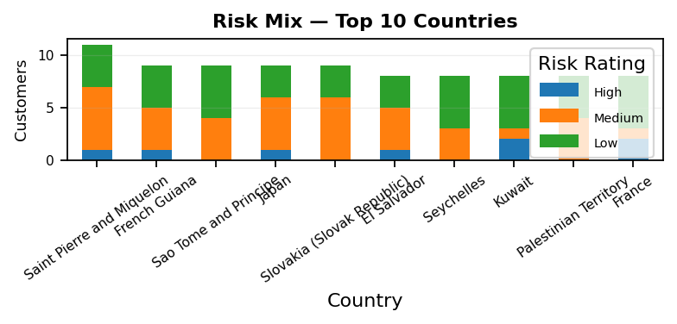
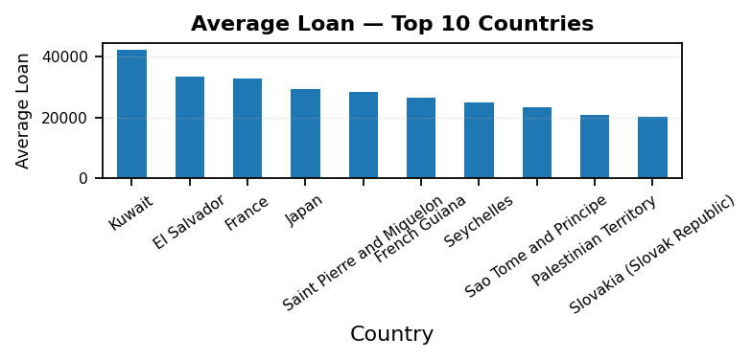
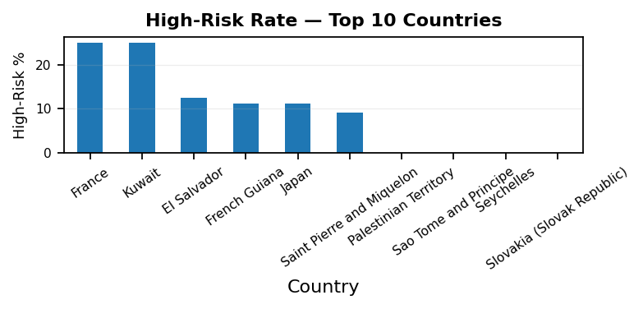
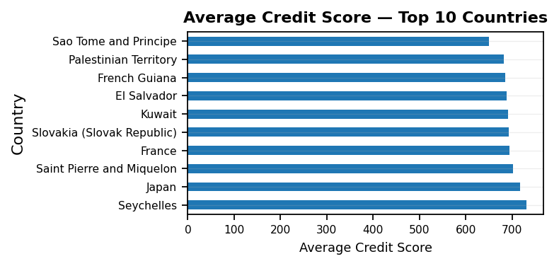
Dashboard 14 — Geographic Risk Profile
Owner: Person 4 • New dashboard — distinct analytical theme
1,000
89
698.7
26.8K
Total Records
High-Risk Customers
Average Credit Score
Average Loan Amount
TEAM 5 • 17

Slide 18
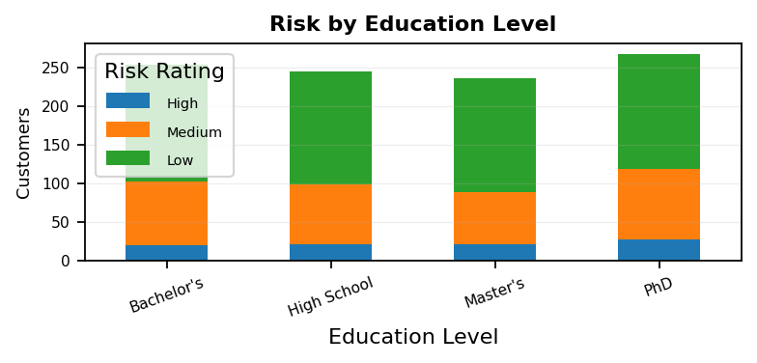
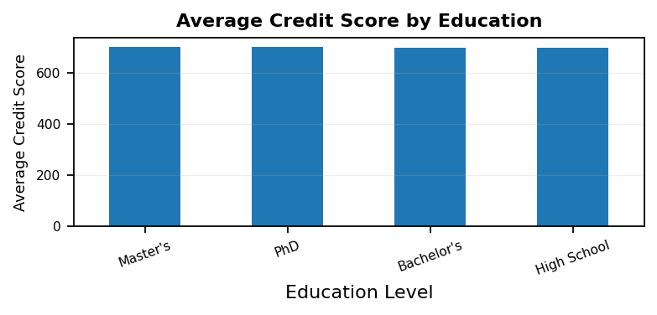
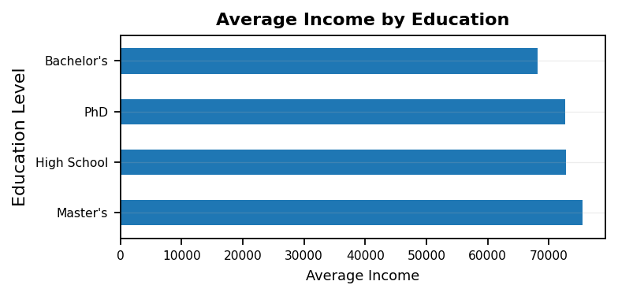
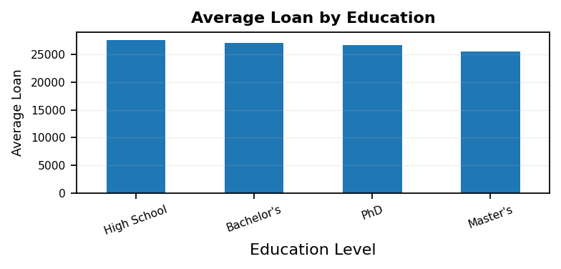
Dashboard 15 — Education & Financial Risk
Owner: Person 4 • New dashboard — distinct analytical theme
1,000
89
698.7
26.8K
Total Records
High-Risk Customers
Average Credit Score
Average Loan Amount
TEAM 5 • 18

Slide 19

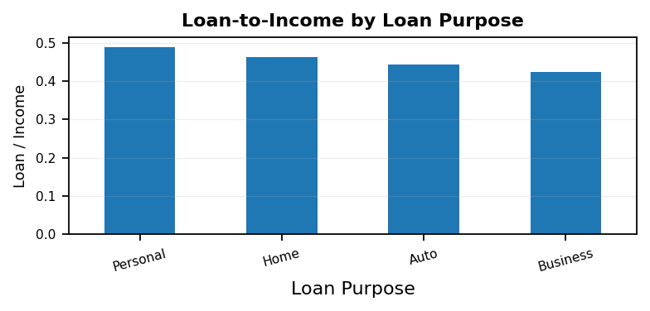


Dashboard 16 — Customer Affordability & Lending Capacity
Owner: Person 4 • New dashboard — distinct analytical theme
1,000
89
698.7
26.8K
Total Records
High-Risk Customers
Average Credit Score
Average Loan Amount
TEAM 5 • 19

Slide 20
Milestone 3 — Final Dashboard Coverage
Milestone 3 Outcome
• Developed 16 financial risk dashboard views across 4 team members. • Retained the existing 4 core dashboards, with Dashboard 3 covering two pages. • Unique dashboards covering income, assets, demographics, loans, payment behavior, employment, DTI, defaults, credit quality, geography, education and affordability. • Created KPI-based and interactive visualizations for customer risk assessment and segmentation. • Enabled detailed analysis of high-risk customers and financial exposure.
TEAM – 5 | Infosys Internship – Data Visualization | Milestone 3
TEAM 5 • 20

